Slide 1
“3 - Image Stitching Using Matlab”
Mini Project - II
PEDDAIAHGARI SREE RAJ - 1NH18EC084
SAI HASAN - 1NH18EC099
V.B.VASU - 1NH18EC115
MAHESH BABU - 1NH18EC118
Guided By
PUVI RAJAN
Professor
Dept. of ECE
New Horizon College of Engineering, Bengaluru

Slide 2
Contents
Introduction
Literature Review
Problem Statement & Objectives
Block Diagram
Software Specification
Algorithm / Flow Chart
Advantages
References
Progress Work
Milestones/Schedule

Slide 3
Introduction
Image stitching combines a number of images taken at high resolution into a composite image. The composite image must consist of images placed at the right position and the aim is to make the edges between images invisible
Image stitching is needed in many applications like
1.Image stabilization feature in camcorders that use frame-rate image alignment
2.High-resolution photos in digital maps and satellite imagery
3.Medical imaging
4.Multiple-image super-resolution imaging
5.Video stitching
6.Object insertion
. The effectiveness of image stitching depends on the overlap removal, matching of the intensity of images, the techniques used for blending the image

Slide 4
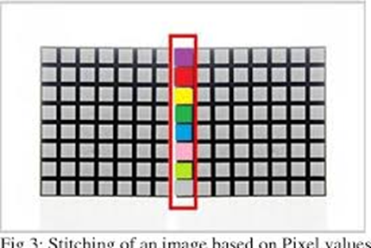
Correlation: . It compares the common variables between two images . It used here to detect key points in images based on pixel values Blending: It computes correlation coefficient between a and b where a and b are the matrix of same matrix. “imshow(I)” displays the grayscale image I. “imshow(I,[low high])” displays the grayscale image I, specifying the display range for I in [low high]. The value low displays as black. The value high displays as white. Values in between are displayed as intermediate shades of gray, using the default number of gray levels. If you use an empty matrix ([]) for [low high], imshow uses [min(I(:)) max(I(:))]; that is, the minimum value in I is displayed as black, and the maximum value is displayed as white.

Slide 5
Literature Review
Title of the paper | Author & Year of Publication | Outcome | Limitation

Slide 6
Existing System
IMAGE STITCHING USING HARRIS FEATURE DETECTION Themainstepsinclude image acquisition, image registration image blending. The image registration process used in this method is a feature based method which uses HARRIS corner detection algorithm for feature detection. The image stitching algorithm is then processed to give a stitched panoramic image.

Slide 7
Problem Statement & Objectives
Problem Statement:The problem with the existing system which
Gives the output image very curvy and image won’t be clear
Objective:The papers goal is to create Matlab scripts that will stitch two images together to create one larger image. Given sequence of images taken from a single point in space, but with varying orientations, it is possible to map the images into common reference frame and create a perfectly aligned larger photograph with a wider field of view. This is normally referred to as image stitching.

Slide 8
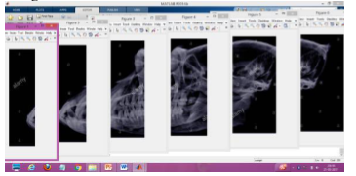
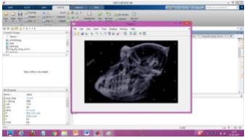
Block Diagram
Images
input
Key point
detection
Key point
matching
Image
alignment
Image
blending
Display
Stitched image

Slide 9
Software Specification
Software used :Matlab-2016
MATLAB (matrix laboratory) is a multi paradigm numerical computing environment and proprietary programming language developed by MathWorks. MATLAB allows matrix manipulations, plotting of functions and data, implementation of algorithms creation of user interfaces, and interfacing with programs written in other languages.

Slide 10
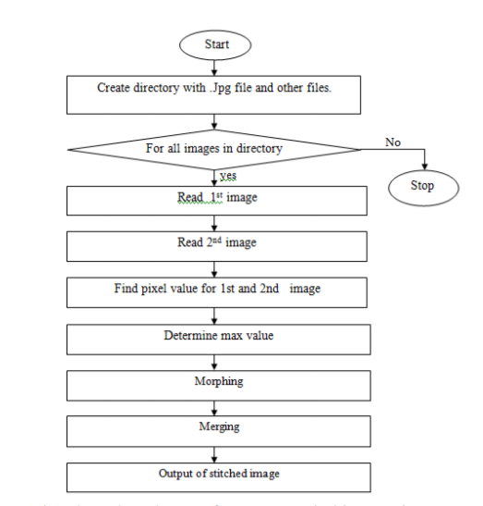
Algorithm / Flow Chart

Slide 11
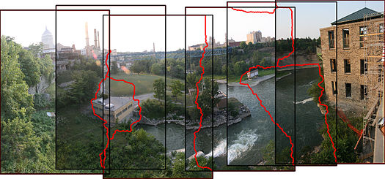
Here the area within the red outline shows the common region in sequence of pairs that repeats in one of pair of images.
Now the images are stitched in a way that the region is repeat only once.

Slide 12
Advantages
Image stitching is most widely used topics in computer vision and graphics.
It is closely associated with the daily lives of people, such as constructing beautiful panoramas with smartphones applications, creating wide field-of-view (FOV) videos for surveillance, and assisting automobiles.
Image stitching algorithms construct a wide-FOV view from a sequence of images
Compared to video stitching, image stitching attracts high attention

Slide 13
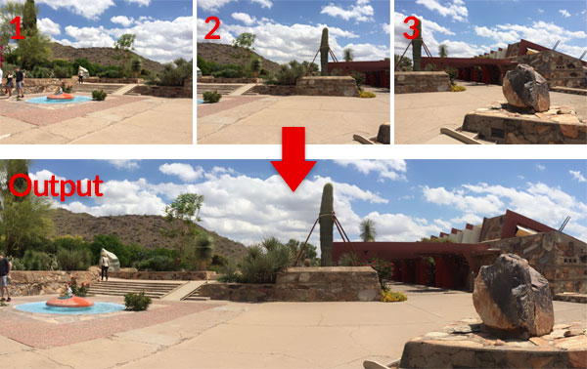
Example

Slide 14
Future Scope
Future Scope
Image stitching is widely used in modern applications, such as the following:
Document mosaicing
Image stabilization feature in camcorders that use frame-rate image alignment
High-resolution photomosaics in digital maps and satellite imagery
Medical imaging
Multiple-image super-resolution imaging
Video stitching
Object insertion

Slide 15
References
[1] Matthew Brown and David G. Lowe. 2007. Automatic Panoramic Image Stitching using Invariant Features. Int. J. Comput. Vision 74, 1 (August 2007), 59-73.
Mann, Steve; Picard, R. W. (November 13–16, 1994). "Virtual bellows: constructing high-quality stills from video" (PDF). Proceedings of the IEEE First International Conference on Image Processing. IEEE International Conference. Austin, Texas: IEEE

Slide 16
,nhce
Progress Work
Group-SREERAJ,HASAN,VASU,MAHESH | WORK ACHEIVED
ALL | MINI PROJECT TITLE
ALL | DESIGNING OF CODE
ALL | MAKING PPT TO PRESENT

Slide 17
Milestones/Schedule
Milestone | Baseline Date | Target Date | Achievement
Title of the project | 28/01/2020 | 03/02/2020 | Success
Approvel of the project | - | 06/02/2020 | Success
FIRST REVIEW | 11/04/2020 | 11/04/2020

Slide 18
Thank You

